Slide 1

Subject Code
18MEO113T - Design of Experiments
Handled by
S. Murali, Ph.D.,
Associate Professor,
Department of Mechanical Engineering, SRM IST, Kattankulathur.
Disclaimer
The content prepared in the presentation are from various sources, only used for education purpose. Thanks to all the sources.

Slide 2
Unit 2

Slide 3
Unit 2
1: Need for DOE methodology.
2: Barriers in the successful application of DOE
3: Practical methodology of DOE and Analytical tools for DOE
4: The confidence interval for the mean response
5: Introduction to Screening design
6: Geometric and non-geometric P-B design
7: Introduction of full factorial design, Basic concepts of 2², 2³ and 2^{k} designs
8: Solving Case studies on Full factorial design with statistics software
9: Solving case studies on Full factorial design with statistics software

Slide 4
Need for DOE methodology
Experimental design methods are also of fundamental importance in engineering design activities, where new products are developed and existing ones improved. Some applications of experimental design in engineering design include
1. Evaluation and comparison of basic design configurations
2. Evaluation of material alternatives
3. Selection of design parameters so that the product will work well under a wide variety
of field conditions, that is, so that the product is robust
4. Determination of key product design parameters that impact product performance
5. Formulation of new products.

Slide 5
Need for DOE methodology
The use of experimental design in product realization can result in products that are easier to manufacture and that have enhanced field performance and reliability, lower product cost, and shorter product design and development time.
Designed experiments also have extensive applications in marketing, market research, transactional and service operations, and general business operations.

Slide 6
Need for DOE methodology
Examples for need
Characterizing a process
Optimizing a process
Designing a product
Formulating a product
Designing a web page

Slide 7
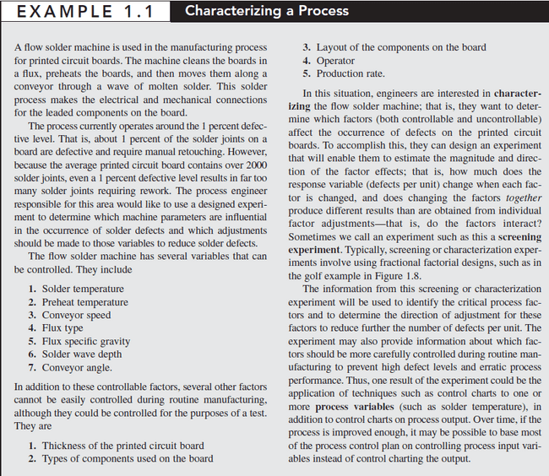
Need for DOE methodology
Characterizing a process

Slide 8
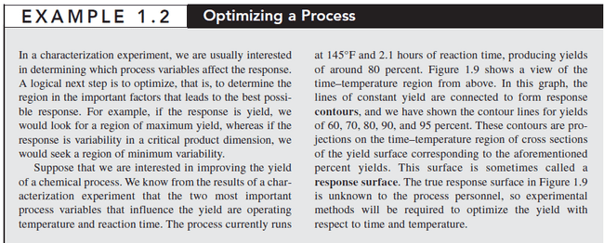
Need for DOE methodology
Optimizing a process

Slide 9
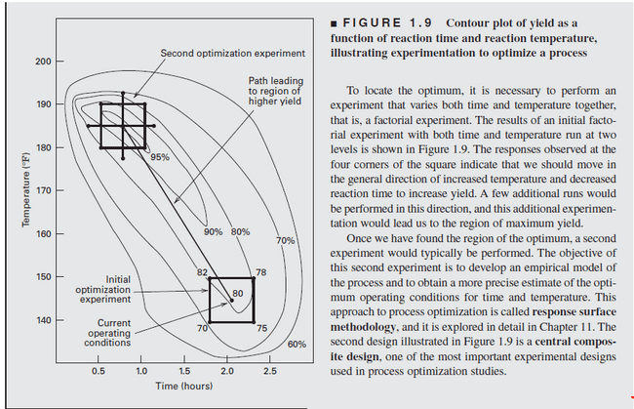
Need for DOE methodology
Optimizing a process

Slide 10
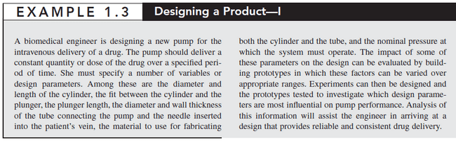


Need for DOE methodology
Designing a Product

Slide 11
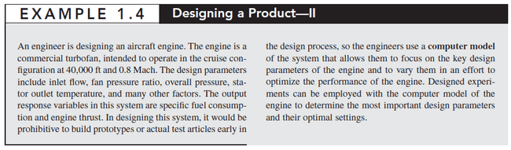
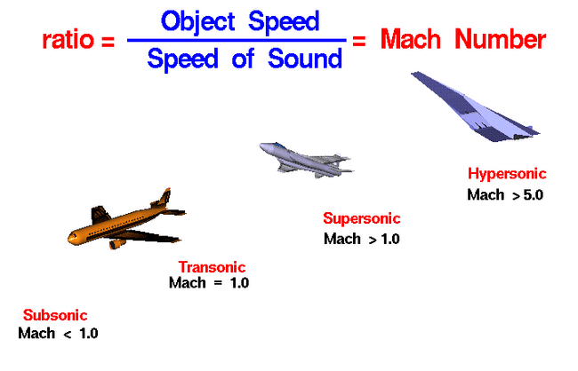
Need for DOE methodology
Designing a Product

Slide 12
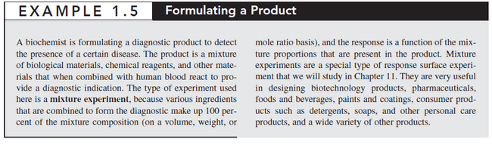
Need for DOE methodology
Formulating a Product

Slide 13
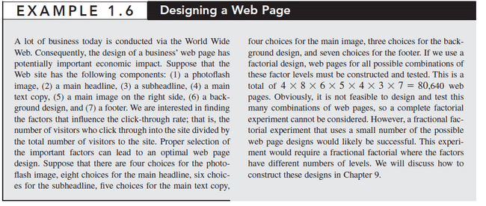
Need for DOE methodology
Designing a Web Page

Slide 14
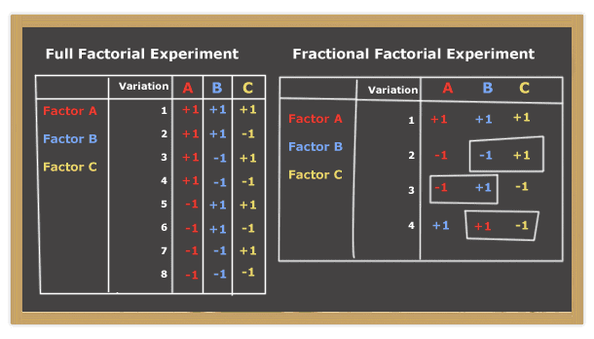
Need for DOE methodology
Designing a Web Page

Slide 15
Barriers in the Successful Application of DOE
The ‘effective’ application of DOE by industrial engineers is limited in many manufacturing organisations.
Some noticeable barriers are as follows:
Educational barriers
Management barriers
Cultural barriers
Communication barriers
Other barriers

Slide 16
Barriers in the Successful Application of DOE
Educational barriers
The word ‘statistics’ invokes fear in many industrial engineers.
The fundamental problem begins with the current statistical education for the engineering community in their academic curriculum. The courses currently available in ‘engineering statistics’ often tend to concentrate on the theory of probability, probability distributions and more mathematical aspects of the subject, rather than practically useful techniques such as DOE, Taguchi method, robust design, gauge capability studies, Statistical Process Control (SPC), etc.

Slide 17
Barriers in the Successful Application of DOE
Management barriers
Managers often don’t understand the importance of DOE in problem solving or don’t appreciate the competitive value it brings into the organisation. In many organisations, managers encourage their engineers to use the so-called ‘home-grown’ solutions for process and quality-related problems.
These ‘home-grown’ solutions are consistent with the OVAT approach to experimentation, as managers are always after quick-fix solutions which yield short-term benefits to their organisations.

Slide 18
Barriers in the Successful Application of DOE
Management barriers
Responses from managers with high resistance to change may include the following
DOE tells me what I already know.
It sounds good, but it is not applicable to my job.
I need to make additional effort to prove what I already know.
Many managers do not instinctively think statistically, mainly because they are not convinced that statistical thinking adds any value to management and decision-making.
Managers in organisations believe that DOE is very demanding of resources.

Slide 19
Barriers in the Successful Application of DOE
Cultural barriers
Cultural barriers are one of the principal reasons why DOE is not commonly used in many organisations.
Many organisations are not culturally ready for the introduction and implementation of advanced quality improvement techniques such as DOE and Taguchi.
The best way to overcome this barrier is through intensive training programs and by demonstrating the successful application of such techniques by other organisations during the training.

Slide 20
Barriers in the Successful Application of DOE
Communication barriers
Research has indicated that there is very little communication between the academic and industrial worlds.
Moreover, the communication among industrial engineers, managers and statisticians in many organisations is limited.
For the successful initiative of any quality improvement programme, these communities should work together and make this barrier less formidable.

Slide 21
Barriers in the Successful Application of DOE
Other barriers
Negative experiences with DOE may make companies reluctant to use DOE again. The majority of negative DOE experiences can be classified into two groups. The first relates to technical issues and the second to non-technical issues.
Technical issues include:
choosing unreasonably large or small designs;
inadequate or even poor measurement of quality characteristics;
not choosing the appropriate levels for the process variables, etc. Non-linearity or curvature effects of process variables should be explored to determine the best operating process conditions;
assessing the impact of ‘uncontrolled variables’ which can influence the output of the process. Experimenters should try to understand how the ‘uncontrolled variables’ influence the process behaviour and devise strategies to minimise their impact as much as possible;
Lacking awareness of assumptions: data analysis, awareness of different alternatives why they are needed, etc.

Slide 22
Barriers in the Successful Application of DOE
Non-Technical issues include:
lack of experimental planning;
executing one-shot experimentation instead of adopting sequential, adaptive and iterative nature of experimentation
not choosing the right process variables or design variables for the experiment in the first round of experimentation, etc.

Slide 23
Barriers in the Successful Application of DOE
Educational barriers
Current statistical education for the engineering community in their academic curriculum is not sufficient
Management barriers
Managers encourage their engineers to use ‘home-grown’ solutions for process-and quality-related problems.
Cultural barriers
Principal reason; reluctant and fear of embracing the DOE
Communication barriers
Gap between academia and industry ; lack of knowledge in engineering and statistics
Other barriers
Technical and non-technical issues might bring negative experiences with DOE; makes engineers reluctant to use DOE

Slide 24
Barriers in the Successful Application of DOE
Commercial software systems and expert systems in DOE provide no guidance whatsoever in classifying and analysing manufacturing process quality-related problems from which a suitable approach (Taguchi, Classical or Shainin’s approach) can be selected.

Slide 25
Barriers in the Successful Application of DOE
The selection of a particular approach to experimentation (i.e. Taguchi, Classical or Shainin) is dependent upon a number of criteria:
the complexity involved
the degree of optimisation required by the experimenter
the time required for completion of the experiment
cost issues associated with the experiment
the allowed response time to report back to management, etc.

Slide 26
A Practical Methodology for DOE
The methodology of DOE is fundamentally divided into four phases.
These are:
1. planning phase
2. designing phase
3. conducting phase
4. analysing phase.

Slide 27
Planning Phase
Many engineers pay special attention on the statistical details of DOE and very little attention to the non-statistical details.
Experimental studies may fail not only as a result of lack of technical knowledge of the process under study or wrong use of statistical techniques but also due to lack of planning.
It is the responsibility of the senior management team in the organisation to create an environment that stimulates a culture of using experimental design techniques for process optimisation problems, product and process development projects, improving process capability through systematically reducing excessive variation in processes, etc.

Slide 28
Planning Phase
The planning phase is made up of the following steps.
Problem Recognition and Formulation
Selection of Response or Quality Characteristic
Selection of Process Variables or Design Parameters
Classification of Process Variables
Determining the Levels of Process Variables
List All the Interactions of Interest

Slide 29
Planning Phase
1. Problem Recognition and Formulation
A clear and succinct statement of the problem can create a better understanding of what needs to be done. The statement should contain an objective that is specific, measurable and which can yield practical value to the company (Kumar and Tobin, 1990). The creation of a multidisciplinary team in order to have a shared understanding of the problem is critical in the planning phase. The multidisciplinary team should be led by someone with good knowledge of the process (a DOE specialist), good communication skills, good interpersonal skills and awareness of team dynamics.
Other team members may include process engineers, a quality engineer/manager, a machine operator, a management representative and manufacturing/production engineers/managers. Sharing experiences and individual knowledge is critical to assure a deeper understanding of the process providing more efficient ways to design experiments (Romeu, 2006).

Slide 30
Planning Phase
1. Problem Recognition and Formulation
Some manufacturing problems that can be addressed using an experimental approach include
development of new products; improvement of existing processes or products;
improvement of the process/product performance relative to the needs and demands of customers;
reduction of existing process spread, which leads to poor capability.
The objective of the experiment must be clearly specified and has to be measurable.
Objectives can be either short term or long term. A short-term objective could be to fix a problem related to a high scrap rate.

Slide 31
Planning Phase
2. Selection of Response or Quality Characteristic
The selection of a suitable response for the experiment is critical to the success of any industrially designed experiment.
The response can be variable or attribute in nature.
Variable responses such as length, thickness, diameter, viscosity, strength, etc. generally provide more information than attribute responses such as good/bad, pass/fail or yes/no.
Moreover, variable characteristics or responses require fewer samples than attributes to achieve the same level of statistical significance.

Slide 32
Planning Phase
2. Selection of Response or Quality Characteristic
Experimenters should define the measurement system prior to performing the experiment in order to understand what to measure, where to measure and who is doing the measurements, etc. so that various components of variation (measurement system variability, operator variability, part variability, etc.) can be evaluated.
Defining a measurement system, including human resources, equipments and measurement methods, is a fundamental aspect in planning experimental studies.
It is important to ensure that equipment exists and is suitable, accessible and calibrated.

Slide 33
Planning Phase
2. Selection of Response or Quality Characteristic
The quality of a measurement system is usually determined by the statistical properties of the data it generates over a period of time which captures both long- and short-term variation.
Experimenters should be aware of the repeatability, reproducibility and uncertainty of the measurements prior to the execution of industrial experiments (Launsby and Weese, 1995).
It is advisable to make sure that the measurement system is capable, stable, robust and insensitive to environmental changes.

Slide 34
Planning Phase
3. Selection of Process Variables or Design Parameters
Some possible ways to identify potential process variables are the use of engineering knowledge of the process, historical data, cause-and-effect analysis and brainstorming.
It is a good practice to conduct a screening experiment in the first phase of any experimental investigation to identify the most important design parameters or process variables.

Slide 35
Planning Phase
4. Classification of Process Variables
After identification of process variables , classify them into controllable and uncontrollable variables
Control variables are those which can be controlled by a process engineer/production engineer in a production environment.
Uncontrollable variables (or noise variables) are those which are difficult or expensive to control in actual production environments.

Slide 36
Planning Phase
4. Classification of Process Variables
Variables such as ambient temperature fluctuations, humidity fluctuations, raw material variations, etc. are examples of noise variables.
The effect of such nuisance variables can be minimized by the effective application of DOE principles such as blocking, randomization and replication.

Slide 37
Planning Phase
5. Determining the Levels of Process Variables
A level is the value that a process variable holds in an experiment.
For example, a car’s gas mileage is influenced by such levels as tire pressure, speed, etc.
The number of levels depends on the nature of the process variable to be studied for the experiment and whether or not the chosen process variable is qualitative (type of catalyst, type of material, etc.) or quantitative (temperature, speed, pressure, etc.).

Slide 38
Planning Phase
5. Determining the Levels of Process Variables
For quantitative process variables, two levels are generally required in the early stages of experimentation.
However, for qualitative variables, more than two levels may be required. If a non-linear function is expected by the experimenter, then it is advisable to study variables at three or more levels.
This would assist in quantifying the nonlinear (or curvature) effect of the process variable on the response function.

Slide 39
Planning Phase
6. List all the Interactions of Interest
Interaction among variables is quite common in industrial experiments.
In order to effectively interpret the results of the experiment, it is highly desirable to have a good understanding of the interaction between two process variables (Marilyn, 1993).
The best way to relate to interaction is to view it as an effect, just like a factor or process variable effect.
In the context of DOE, we generally study two-order interactions.
The number of two-order interactions within an experiment can be easily obtained by using a simple equation:
$$N= \frac{n ∗(n−1)}{2}$$
Where n is the number of factors.

Slide 40
Planning Phase
6. List all the Interactions of Interest
For example, if you consider four factors in an experiment, the number of two order interactions can be equal to six.
The questions to ask include
‘Do we need to study the interactions in the initial phase of experimentation?’
‘How many two-order interactions are of interest to the experimenter?’
The size of the experiment is dependent on the number of factors to be studied and the number of interactions, which are of great concern to the experimenter.

Slide 41
Designing Phase
During the design stage, it is quite important to consider the confounding structure and resolution of the design.
Confounding
A concept that basically means that multiple effects are tied together into one parent effect and cannot be separted. For example,
Two people fipping two different coins would result in the effect of the person and the effect of the coin to be confounded.
It is good practice to have the design matrix ready for the team prior to executing the experiment.

Slide 42
Designing Phase
The design matrix generally reveals all the settings of factors at different levels and the order of running a particular experiment.
Experimenters are advised to carefully consider the three principles (randomisation, replication and blocking) of experimental design prior to conducting the real experiment.

Slide 43
Conducting Phase
This is the phase in which the planned experiment is carried out and the results are evaluated.
Several considerations are recognized as being recommended prior to executing an experiment, such as
selection of a suitable location for carrying out the experiment. It is important to ensure that the location is not affected by any external sources of noise (vibration, humidity, etc.);
availability of materials/parts, operators, machines, etc. required for carrying out the experiment;

Slide 44
Conducting Phase
The following steps may be useful while performing the experiment in order to ensure that it is performed according to the prepared experimental design matrix (or layout).
The person responsible for the experiment should be present throughout the experiment. In order to reduce the operator-to-operator variability, it is best to use the same operator for the entire experiment.
Monitor the experimental trials. This is to find any discrepancies while running the experiment. It is advisable to stop running the experiment if any discrepancies are found.
Record the observed response values on the prepared data sheet or directly into the computer.
Any experiment deviations and unusual occurrences must be recorded and analysed.

Slide 45
Analysing Phase
Having performed the experiment, the next phase is to analyze and interpret the results so that valid and sound conclusions can be derived.
The following are the objectives to be achieved ,
Determine the design parameters or process variables that affect the mean process performance.
Determine the design parameters or process variables that influence performance variability.
Determine the design parameter levels that yield the optimum performance.
Determine whether further improvement is possible.

Slide 46
Analysing Phase
Statistical methods should be used to analyze the data.
Analysis of variance is widely used to test the statistical significance of the effects through F-Test.
Confidence interval estimation is also part of the data analysis. empirical models are developed relating the dependent (response) and independent variables (factors).
Residual analysis and model adequacy checking are also part of the data analysis procedure.
Statistical analysis of data is a must for academic and scientific purpose.
Graphical analysis and normal probability plot of the effects may be preferred by Industry

Slide 47
Analytical Tools of DOE
Main Effects Plot
A main effects plot is a plot of the mean response values at each level of a design parameter or process variable.
One can use this plot to compare the relative strength of the effects of various factors.
The sign and magnitude of a main effect would tell us the following:
The sign of a main effect tells us of the direction of the effect, that is, whether the average response value increases or decreases.
The magnitude tells us of the strength of the effect.

Slide 48
Analytical Tools of DOE
Main Effects Plot
If the effect of a design or process parameter is positive, it implies that the average response is higher at a high level rather than a low level of the parameter setting.
In contrast, if the effect is negative, it means that the average response at the low-level setting of the parameter is more than at the high level.

Slide 49
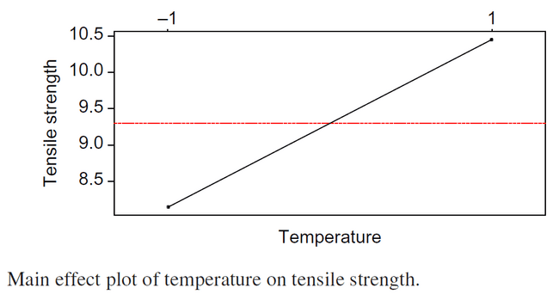
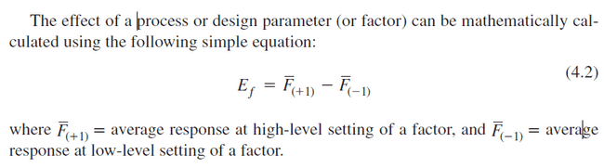
Analytical Tools of DOE
Main Effects Plot
Effect of a process

Slide 50
Analytical Tools of DOE
Interactions Plots
An interactions plot is a powerful graphical tool which plots the mean response of two factors at all possible combinations of their settings.
If the lines are parallel, this indicates that there is no interaction between the factors.
Non-parallel lines are an indication of the presence of interaction between the factors.

Slide 51
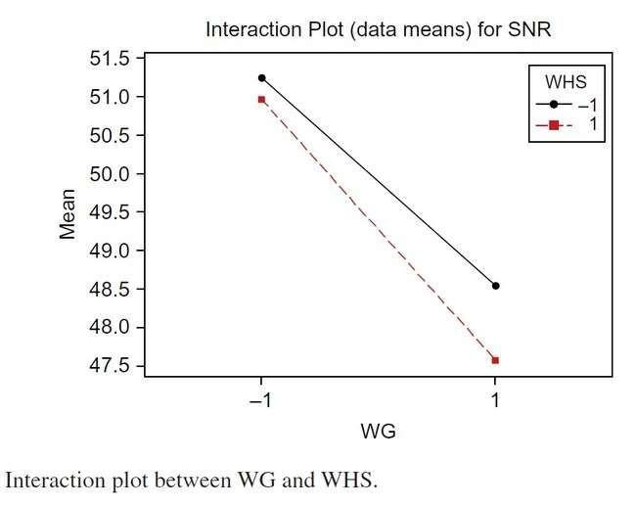
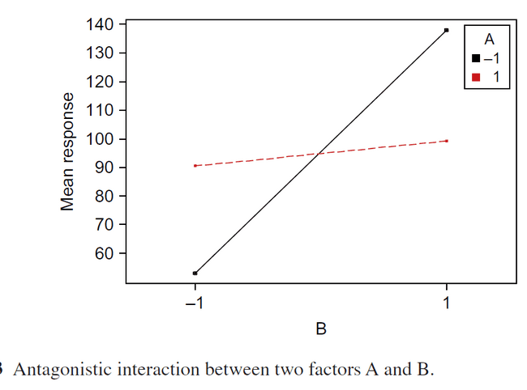
Analytical Tools of DOE
Interactions Plots
Synergistic Interaction : lines nearly parallel – negligible or no interaction exists
Antagonistic Interaction : lines intersect and cross each other– strong interaction exists

Slide 52
Analytical Tools of DOE
Cube Plots
Cube plots display the average response values at all combinations of process or design parameter settings.
One can easily determine the best and worst combinations of factor levels for achieving the desired optimum response.
A cube plot is useful to determine the path of steepest ascent or descent for optimisation problems.

Slide 53

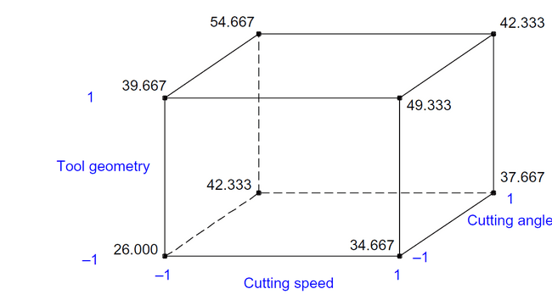
Analytical Tools of DOE
Cube Plots
Figure below illustrates an example of a cube plot for a cutting tool life optimisation study with three tool parameters: cutting speed, tool geometry and cutting angle.
The graph indicates that tool life increases when cutting speed is set at low level and cutting angle and tool geometry are set at high levels.
The worst condition occurs when all factors are set at low levels.

Slide 54
Analytical Tools of DOE
Pareto Plot of Factor Effects
To detect the factor and interaction effects that are most important to the process or design optimisation
It displays the absolute values of the effects, and draws a reference line on the chart.
Any effect that extends past this reference line is potentially important.

Slide 55
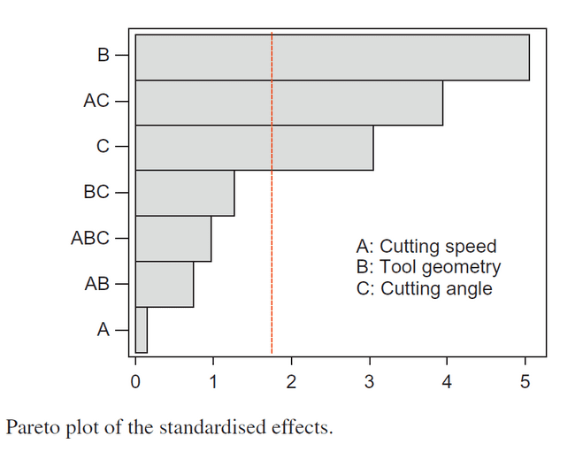
Analytical Tools of DOE
Pareto Plot of Factor Effects
The graph shows that factors B and C and interaction AC are most important.
It is always a good practice to check the findings from a Pareto chart with Normal Probability Plot (NPP) of the estimates of the effects

Slide 56
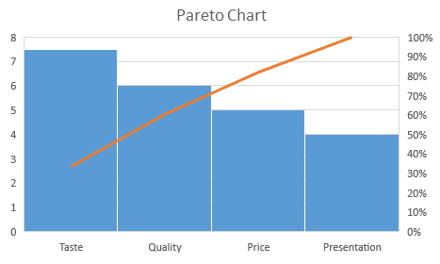
Analytical Tools of DOE
Pareto Plot of Factor Effects
Let us take an example, where we need to prepare a chart of feedback analysis for XYZ restaurant, as per the reviews and ratings received from the customers. Here the customers are given a checklist of four points based on which they have to rate the restaurant out of 10. The four points are:
Taste of the Food
Quality of the food
Price
Presentation

Slide 57
Analytical Tools of DOE
NPP (Normal Probability Plot) of Factor Effects
For NPP, the main and interaction effects of factors or process (or design) parameters should be plotted against cumulative probability (%).
Inactive main and interaction effects tend to fall roughly along a straight line, whereas active effects tend to appear as extreme points falling off each end of the straight line (Benski, 1989).

Slide 58
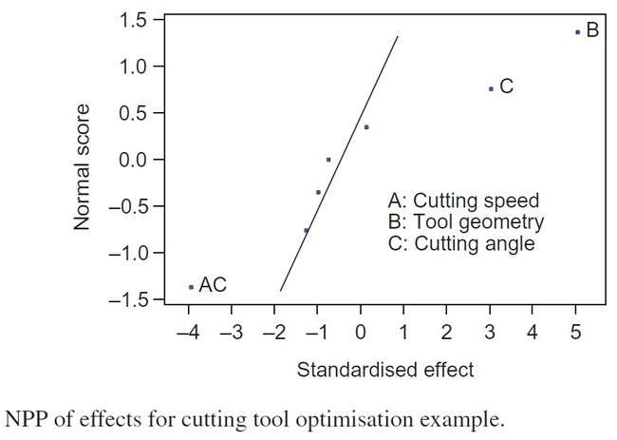
Analytical Tools of DOE
NPP of Factor Effects
These active effects are judged to be statistically significant.
The results are absolutely identical to that of a Pareto plot of factor/ interaction effects.

Slide 59
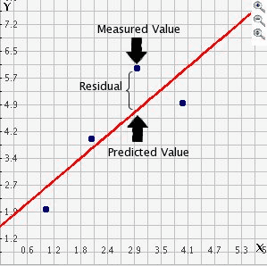
Analytical Tools of DOE
NPP of Residuals
One of the key assumptions for the statistical analysis of data from industrial experiments is that the data come from a normal distribution.
In order to check the data for normality, it is best to construct an NPP (Normal Probability Plot ) of the residuals.
NPPs are useful for evaluating the normality of a data set, even when there is a fairly small number of observations.
Here residual is the mean difference between the observed value (obtained from the experiment) and the predicted or fitted value.

Slide 60
Analytical Tools of DOE
NPP of Residuals
If the residuals fall approximately along a straight line, they are then normally distributed.
In contrast, if the residuals do not fall fairly close to a straight line, they are then not normally distributed and hence the data do not come from a normal population.
In the graph , points fall fairly close to a straight line, indicating that the data are approximately normal.

Slide 61
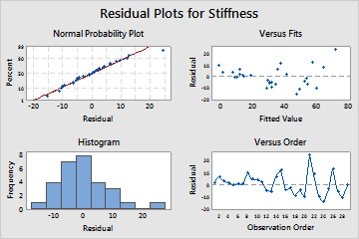
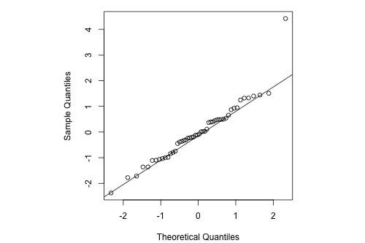
Analytical Tools of DOE
NPP of Residuals

Slide 62
Analytical Tools of DOE
Response Plots
Response surface plots(display 3D views) such as contour and surface plots are useful for establishing desirable response values and operating conditions.
In a contour plot, the response surface is viewed as a two- dimensional plane where all points that have the same response are connected to produce contour lines of constant responses.
A surface plot generally displays a three-dimensional view that may provide a clearer picture of the response.

Slide 63
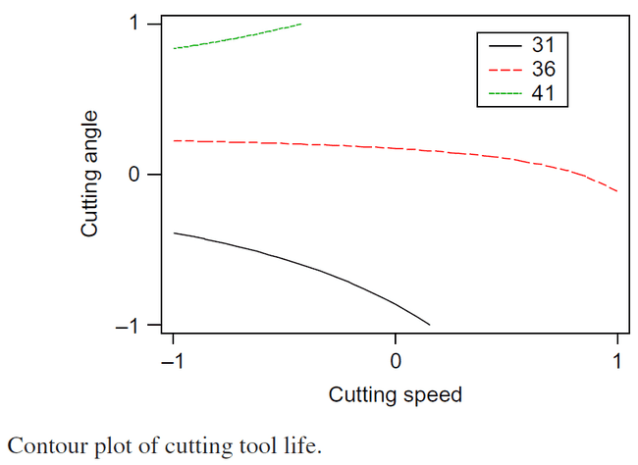
Analytical Tools of DOE
Response Contour Plots
In this Figure, the tool life increases with an increase in cutting angle and a decrease in cutting speed.
If the regression model (i.e. first-order model) contains only the main effects and no interaction effect, the fitted response surface will be a plane (i.e. contour lines will be straight).
If the model contains interaction effects, the contour lines will be curved and not straight.
The contours produced by a second-order model will be elliptical in nature.

Slide 64
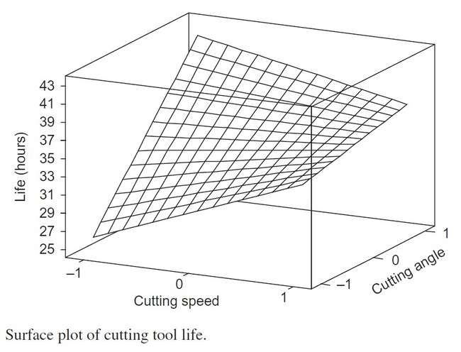
Analytical Tools of DOE
Response Surface Plots
Surface plots are diagrams of three-dimensional data. Rather than showing the individual data points, surface plots show a functional relationship between a designated dependent variable (Y), and two independent variables (X and Z). The plot is a companion plot to the contour plot.

Slide 65
Analytical Tools of DOE
Response Surface Plots
Moreover, we have used a fitted surface in latter figure to find a direction of potential improvement for a process.
A formal way to seek the direction of improvement in process optimisation problems is called the method of steepest ascent or descent (depending on the nature of the problem at hand, i.e. whether one needs to maximize or minimize the response of interest).

Slide 66
Model for Predicting Response Function
Use of this regression model is to predict the response for different combinations of process parameters (or design parameters) at their best levels.
In order to develop a regression model based on the significant effects (either main or interaction), the first step is to determine the regression coefficients.
Regression coefficients are estimates of the unknown population parameters and describe the relationship between a predictor variable and the response. In linear regression, coefficients are the values that multiply the predictor values. Suppose you have the following regression equation: y = 3X + 5. In this equation, +3 is the coefficient, X is the predictor, and +5 is the constant.

Slide 67
Model for Predicting Response Function
Regression coefficients
The sign of each coefficient indicates the direction of the relationship between a predictor variable and the response variable.
A positive sign indicates that as the predictor variable increases, the response variable also increases.
A negative sign indicates that as the predictor variable increases, the response variable decreases.
Example: The coefficient value represents the mean change in the response given a one unit change in the predictor. For example, if a coefficient is +3, the mean response value increases by 3 for every one unit change in the predictor.

Slide 68
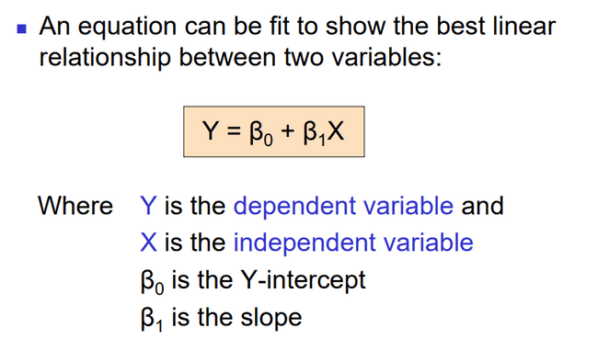
Overview of Linear Models

Slide 69
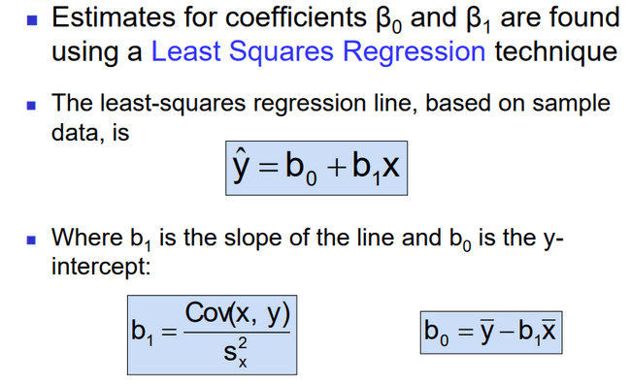
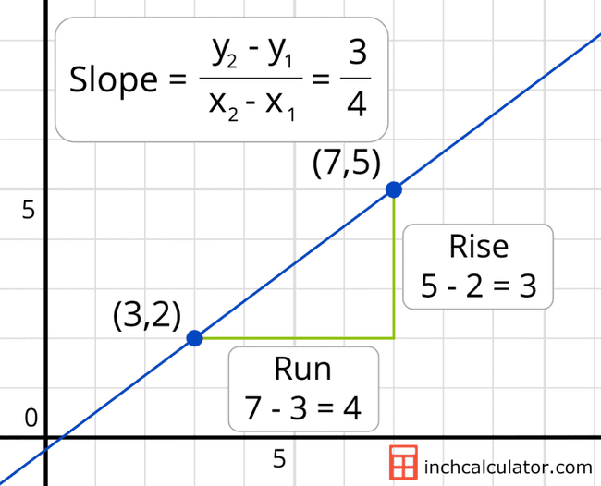
Least Squares Regression

Slide 70
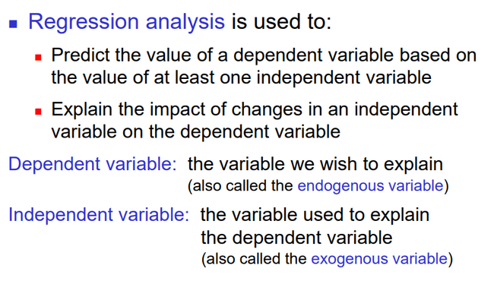
Introduction to Regression Analysis

Slide 71
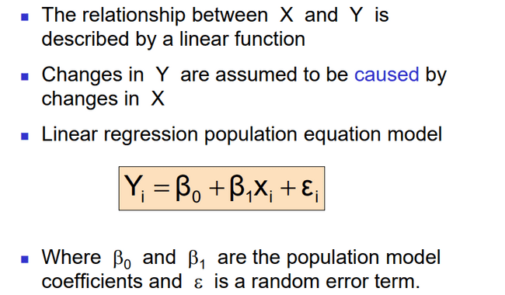
Linear Regression Model

Slide 72
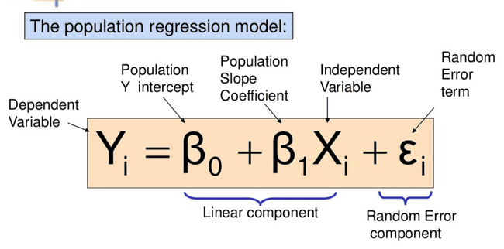
Simple Linear Regression Model

Slide 73
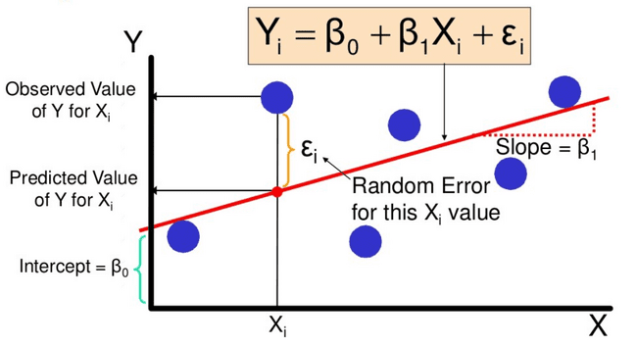
Simple Linear Regression Model
Dependent variable (Y)
Independent variable (X)
Sum of Squares of Error should be minimal, then only we can say that it is best regression line.

Slide 74
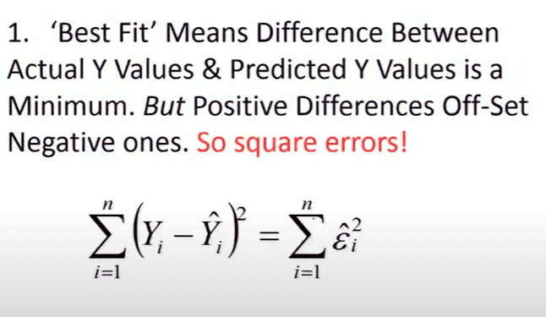
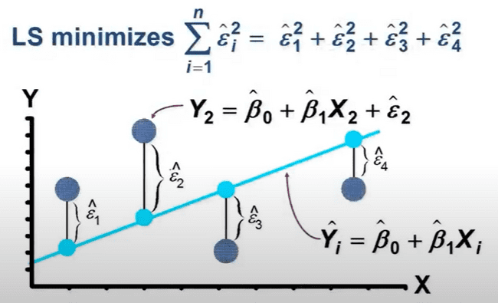
Simple Linear Regression Model
Line of best fit: Best fit means that the sum of the squares of the vertical distance from each point to the line is at minimum.

Slide 75
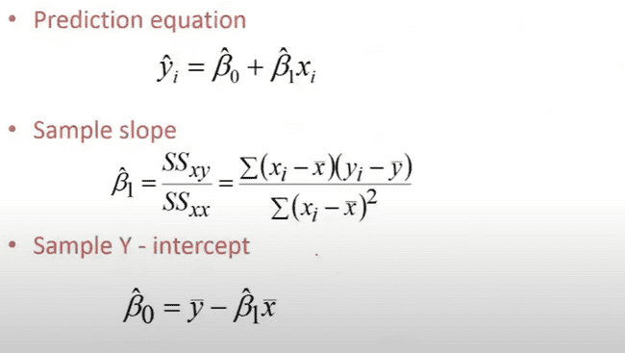
Simple Linear Regression Model

Slide 76
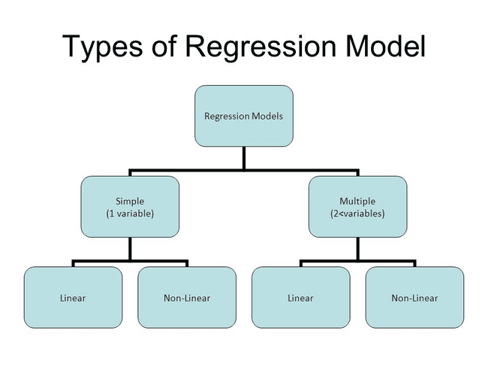
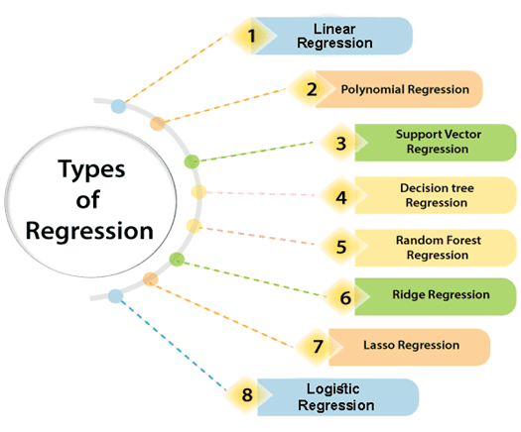
Regression Model

Slide 77
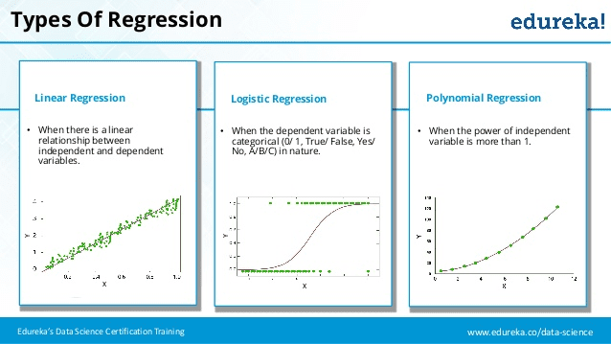
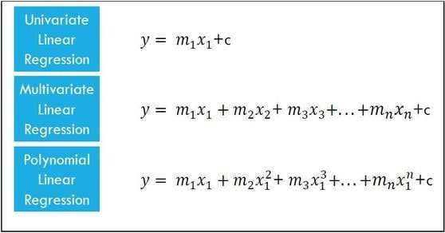
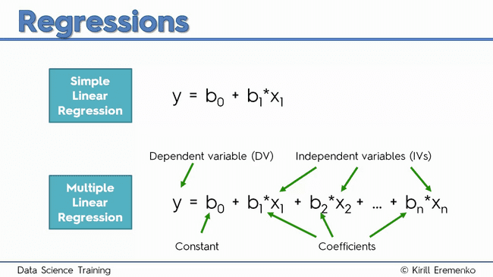
Regression Model

Slide 78
Model for Predicting Response Function
For factors at 2-levels, the regression coefficients are obtained by dividing the estimates of effects by 2.
A regression model for factors at 2-levels is usually of the form
where β₁ and β₂ are the regression coefficients and β₀ is the
average response in a factorial experiment.
The term ‘ε’ the random error component which is approximately normal and independently distributed with mean zero and constant variance σ₂.
The regression coefficient β₁₂ corresponds to the interaction between the process parameters x1 and x2

Slide 79
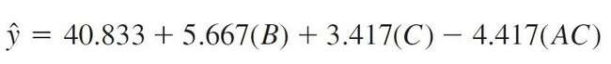
Model for Predicting Response Function
For example, the regression model for the cutting tool life optimisation study is given by
The response values obtained from above Eq. are called predicted values and the actual response values obtained from the experiment are called observed values.

Slide 80
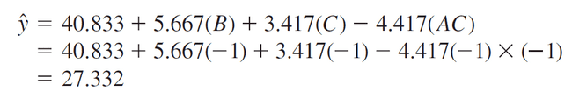
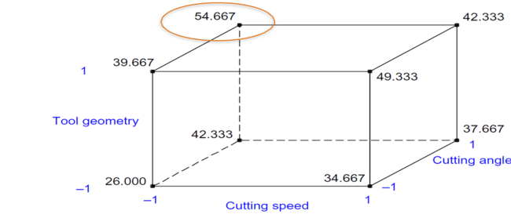
Model for Predicting Response Function
Residuals can be obtained by taking the difference of observed and predicted (or fitted) values.
We can predict the cutting tool life for various combinations of these tool parameters.
For instance, if all the cutting tool life parameters are kept at low level settings, the predicted tool life then would be

Slide 81
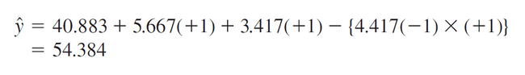
Model for Predicting Response Function
The observed value of tool life (refer to cube plot) is 26 h.
The difference between the observed value and predicted value (i.e. residual) is − 1.332.
Similarly, if all the cutting tool life parameters are kept at the optimal condition (i.e. cutting speed = low, tool geometry = high and cutting angle = high), the predicted tool life would then be

Slide 82
Model for Predicting Response Function
Once the statistical analysis is performed on the experimental data, it is important to verify the results by means of confirmatory experiments or trials.
The number of confirmatory runs at the optimal settings can vary from 4 to 20 (4 runs if expensive, 20 runs if cheap).

Slide 83
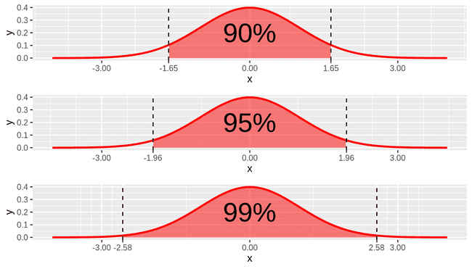
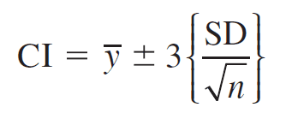
Confidence Interval for the Mean Response
The statistical confidence interval (CI) (at 99% confidence limit) for the mean response can be computed using the equation
where
y = mean response obtained from confirmation trials or runs
SD = standard deviation of response obtained from confirmation trials
n = number of samples (or confirmation runs).

Slide 84
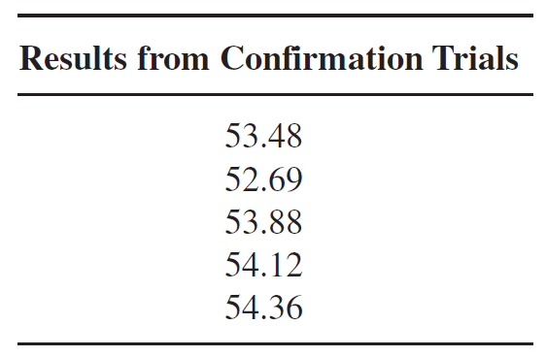
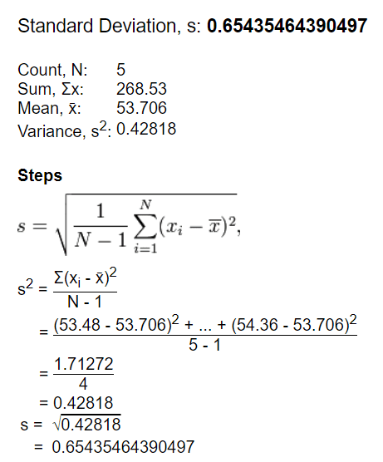
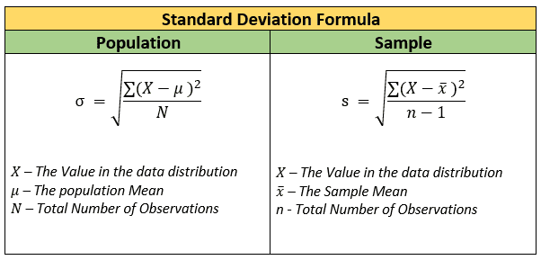
Confidence Interval for the Mean Response
For the cutting tool life example, five samples were collected from the process at the optimal condition (i.e. cutting speed = low, tool geometry = high and cutting angle = high).
Confirmation trials
Y(bar) = 53.71h SD = 0.654 h

Slide 85
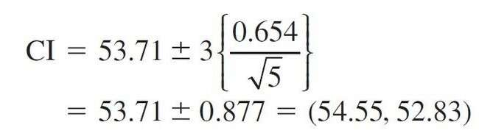
Confidence Interval for the Mean Response
99% CI for the mean response is given by:
As the predicted value (54.384) based on the regression model falls within the statistical CI, we will consider our model good.

Slide 86
Confidence Interval for the Mean Response
If the results from the confirmation trials or runs fall outside the statistical CI, possible causes must be identified. Some of the possible causes may be
incorrect choice of experimental design for the problem at hand
improper choice of response(s) for the experiment
inadequate control of noise factors, which cause excessive variation
omission of some important process or design parameters in the first rounds of experimentation
measurement error
wrong assumptions regarding interactions
errors in conducting the experiment, etc.

Slide 87
Confidence Interval for the Mean Response
If the results from the confirmatory trials or runs are within the CI, then improvement action on the process is recommended.
The new process or design parameters should be implemented with the involvement of top management.
After the solution has been implemented, control charts on the response(s) or key process parameters should be constructed for constantly monitoring, analyzing, managing and improving the process performance.

Slide 88
Screening Designs
In many process development and manufacturing applications, the number of potential process or design variables or parameters (or factors) is large.
Screening reduces the number of process or design parameters (or factors) by identifying the key factors affecting product quality or process performance.
This reduction allows one to focus process improvement efforts on the few really important factors, or the ‘vital few’.

Slide 89
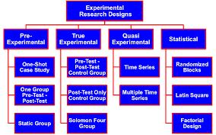
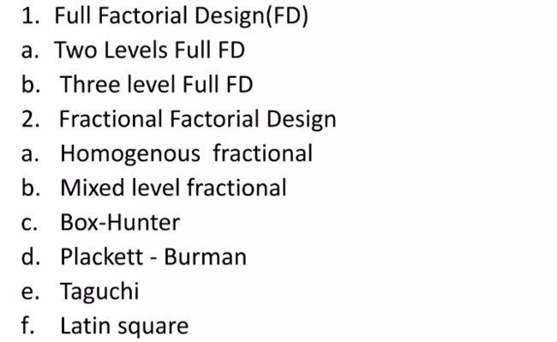
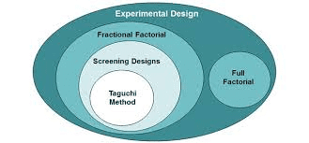
Types of Factorial Design

Slide 90

Full Factorial Design

Slide 91

Full Factorial Design

Slide 92

Full Factorial Design

Slide 93

Fractional Factorial Design

Slide 94


Slide 95


Slide 96


Slide 97


Slide 98



Slide 99


Slide 100


Resolution Design

Slide 101

Resolution Design

Slide 102


Slide 103
Screening Designs
Screening designs provide an effective way to consider a large number of process or design parameters (or factors) in a minimum number of experimental runs or trials (i.e. with minimum resources and budget).
The purpose of screening designs is to identify and separate out those factors that demand further investigation.
For screening designs, experimenters are generally not interested in investigating the nature of interactions among the factors (Antony, 2002).

Slide 104
P-B design
Focus on - Screening Designs expounded by R.L. Plackett and J.P. Burman in 1946 – hence the name Plackett–Burman designs (P–B designs).
P–B designs are based on Hadamard matrices in which the number of experimental runs or trials is a multiple of four, i.e. N = 4, 8, 12, 16 and so on, where N is the number of trials/runs (Plackett and Burmann, 1946).
P–B designs are suitable for studying up to k = (N−1)/(L−1) factors, where L is the number of levels and k is the number of factors.
For instance, using a 12-run experiment, it is possible to study up to 11 process or design parameters at 2-levels.

Slide 105

P-B design
One of the interesting properties of P–B designs is that all main effects are estimated with the same precision. This implies that one does not have to anticipate which factors are most likely to be important when setting up the study.
Resolution III Design→ No main effects are confounded (aliased) with any other main effect, but main effects are confounded with two-factor interactions.

Slide 106
P-B design
The aim of P-B design is to study as many factors as possible in a minimum number of trials and to identify those that need to be studied in further rounds of experimentation in which interactions can be more thoroughly assessed.
Thus, they can determine which factors are important. i.e., the main effects are interested (not interaction effects)
However, they have the advantage of requiring fewer experimental runs.
P-B design is equivalent to fractional factorial design (are multiples of four but are not powers of two. )
It uses standard orthogonal arrays.
Here, k = N-1, there will be no degrees of freedom available for error to be estimated.

Slide 107
P-B Designs
Advantages:
Limited number of runs to evaluate large number of factors.
Important main effects can be selected for more in- depth study

Slide 108
Disadvantage of P-B Designs
Their disadvantage is their complexity.
As P-B designs can’t be represented as cubes, they are sometimes called nongeometric designs.
Assumption required to evaluate up to k = (N − 1) factors in N runs.
One can study fewer than (N − 1) factors in N runs.
Geometric P–B designs are resolution III designs and therefore these designs can be folded over to achieve a design resolution IV.

Slide 109

P-B Design vs. Fractional factorial

Slide 110
P-B Designs
Geometric
2^{N} (N = 4, 8, 16, 32, etc.)
Geometric designs are identical to fractional factorial designs in which one may be able to study the interactions between factors.
If the process is suspected to be highly interactive
Non-geometric
are multiples of four but are not powers of two. E.g. have runs of 12, 20, 24, 28, etc.
These designs do not have complete confounding of effects.
if interactions are of no concern to the experimenter

Slide 111

P-B Designs

Slide 112

P-B Designs

Slide 113

P-B Designs
Step 1: Assign the levels for a first factor as per P-B design generator table
Step 2: Keep the last run/trail at a low level for all factors.
Step 3: To make levels for consecutive factors follow the cyclic manner as represented.
1
Generator vectors
2

Slide 114
P-B Designs
Step 1: Assign the levels for a first factor as per P-B design generator table
Step 2: Keep the last run/trail at a low level for all factors.
Step 3: To make levels for consecutive factors follow the cyclic manner as represented.

Slide 115

P-B Designs

Slide 116
Ex 1. Paperboard product
This example is based on the manufacturing process of a paperboard product.
The objective of the experiment was to increase the puncture resistance of this paperboard product.
The response or quality characteristic of interest to the team conducting the experiment was the force required to penetrate the material.
The objective was to maximize the mean force required to penetrate the material.

Slide 117

Ex 1. Paperboard product
Number of factors: 7
Number of levels: 2
Hence, it is 2⁷ designs.
Experimental design
2⁷ = 128 runs
P-D = 8 runs

Slide 118

Ex 1. Paperboard product

Slide 119

Ex 1. Paperboard product
Finding key main effects
Minitab software – used for plotting
To identify the key main effects that were most influential on the response (i.e. force).
Active Effects

Slide 120

Ex 1. Paperboard product
Pareto chart –Substantiation
C
E
B

Slide 121

Ex 1. Paperboard product
Main effects
Conclusion: Main effects C (press roll pressure), E (paste type) and B (amount of additive) are found to have significant impact on the mean puncture resistance (i.e. the force required to penetrate the paper board).

Slide 122

Ex 1. Paperboard product
Design Matrix
In order to analyze the factors affecting variability in force, we need to calculate the SD of observations at each experimental design point.

Slide 123


Ex 1. Paperboard product
Normal plot: Effects on SD
The normal plot indicates that only factor F (cure time) influenced the variation in the puncture resistance (i.e. force). Further analysis of factor F has revealed that variability is maximum when cure time is set at high level (i.e. 5 days).

Slide 124
Ex 1. Paperboard product
Conclusion
Factors C, B and E have a significant impact on process average, whereas factor F has a significant impact on process variability.
Other factors such as A, D and G can be set at their economic levels since they do not appear to influence either the process average or the process variability.
The next stage of the experimentation would be to consider the interaction among the factors and select the optimal settings from the experiment that yields maximum force with minimum variability. [ Full or fractional factorial with resolution 4]

Slide 125
Ex 2. Plastic Extrusion Process
Problem : Affection of porosity of plastic parts.
Eight process parameters might have some impact on porosity.
Each factor was studied at 2-levels.
As the total degrees of freedom for studying eight factors at 2-levels is equal to 8, it was decided to Choose a non-geometric 12-run P–B design with 11 degrees of freedom.
The extra 3 degrees of freedom can be used to estimate experimental error.

Slide 126

Ex 2. Plastic Extrusion Process
Design Matrix

Slide 127

Ex 2. Plastic Extrusion Process
Effects of the experiment

Slide 128

Ex 2. Plastic Extrusion Process
Main Effects

Slide 129
Introduction of full factorial design, Basic concepts of 2², 2³ and 2^{k} designs
It is widely accepted that the most commonly used experimental designs in manufacturing companies are full and fractional factorial designs at 2-levels and 3-levels.
Factorial designs would enable an experimenter to study the joint effect of the factors (or process/design parameters) on a response.

Slide 130
Introduction of full factorial design, Basic concepts of 2², 2³ and 2^{k} designs
A full factorial design consists of all possible factor combinations in a test, and, most importantly, varies the factors simultaneously rather than one factor at a time.
Using this approach, the tester can examine both main effects (effect of the independent variables on the dependent variable) and interactions (effect of the interaction between independent variables on the dependent variable) associated with both categorical and continuous factors.

Slide 131

Introduction of full factorial design, Basic concepts of 2², 2³ and 2^{k} designs

Slide 132

Introduction of full factorial design, Basic concepts of 2², 2³ and 2^{k} designs

Slide 133

Introduction of full factorial design, Basic concepts of 2², 2³ and 2^{k} designs
All the experimental design should be balanced and orthogonal.
Balanced: in terms of factors
Orthogonal: in terms of interactions.
Factorial Design always balanced and orthogonal.
Also, it should be Unbiased.

Slide 134

Introduction of full factorial design, Basic concepts of 2², 2³ and 2^{k} designs

Slide 135

Introduction of full factorial design, Basic concepts of 2², 2³ and 2^{k} designs

Slide 136

Introduction of full factorial design, Basic concepts of 2², 2³ and 2^{k} designs

Slide 137

2² factorial designs
F value = variance of the group means (Mean Square Between) / mean of the within group variances (Mean Squared Error)

Slide 138


Example 2² design

Slide 139

Example 2² design

Slide 140

Example 2² design

Slide 141






2² factorial designs

Slide 142

2² factorial designs
Example:
SS_{T} = [28² +36² +18² +31² +25² +32² +19² +30² + 27² +32² +23² +29²] – [80+100+60+90]²/4n

Slide 143

F-Distribution Table (alpha = 0.05) for Critical Value

Slide 144

F-Distribution Table (alpha = 0.025) for Critical Value

Slide 145

F-Distribution Table (alpha = 0.1) for Critical Value

Slide 146
Example 2² design
As an example, consider an investigation into the effect of the concentration of the reactant and the amount of the catalyst on the conversion (yield) in a chemical process. The objective of the experiment was to determine if adjustments to either of these two factors would increase the yield. Let the reactant concentration be factor A and let the two levels of interest be 15 and 25 percent. The catalyst is factor B, with the high level denoting the use of 2 pounds of the catalyst and the low level denoting the use of only 1 pound. The experiment is replicated three times, so there are 12 runs.

Slide 147

Example 2² design

Slide 148

Example 2² design

Slide 149


Example 2² design

Slide 150
2² factorial designs
F value = variance of the group means (Mean Square Between) / mean of the within group variances (Mean Squared Error)

Slide 151
F-Distribution Table (alpha = 0.05) for Critical Value

Slide 152

Example 2² design
Factor A: F Critical Value (1,8) = 5.3177
Factor B: F Critical Value (1,8) = 5.3177
Factor AB: F Critical Value (1,8) = 5.3177
Factor A: F Value > F- Critical Value, P<0.05
Factor B: F Value > F- Critical Value, P<0.05
Factor AB: F Value < F- Critical Value, P>0.05
If F value is greater than the F- Critical Value, then significant difference exists

Slide 153

Example (2) 2² design
An article in the AT&T Technical Journal describes the application of two-level factorial designs to integrated circuit manufacturing. A basic processing step in this industry is to grow an epitaxial layer on polished silicon wafers. The wafers are mounted on a susceptor and positioned inside a bell jar. Chemical vapors are introduced through nozzles near the top of the jar. The susceptor is rotated, and heat is applied.
A deposition time and B arsenic flow rate.
two levels of deposition time are short (-) and long (+)
two levels of arsenic flow rate are 55% (-) and 59%(+)
n=4 replications

Slide 154
Example (2) 2² design

Slide 155



Example (2) 2² design
Effect of A, B, AB..?
SS of A, B, AB..?

Slide 156


2³ factorial design
The experiment consists of k factors, each factor consists of 2 level (+,-)
For example k=3;

Slide 157


2³ factorial design
Main and Interaction Effects

Slide 158








2³ factorial design
Main and Interaction Effects
The value in the brackets are
“Contrast”

Slide 159

2³ factorial design

Slide 160


Example: 2³ Factorial design

Slide 161


Example: 2³ Factorial design

Slide 162
Thank you

Slide 163
`
https://www.sciencedirect.com/book/9780080994178/design-of-experiments-for-engineers-and-scientists
https://www.slideshare.net/juditjnugroho/chap11-simple-regression
https://www.digimat.in/nptel/courses/video/110105087/L51.html

Slide 164

Example 2² design

Slide 165

Example 2² design
Main Effect of A

Slide 166
Example 2² design
Main Effect of B

Slide 167
Example 2² design
Interaction Effect of AB

Slide 168


2³ design

Slide 169

2³ design

Slide 170

2³ design

Slide 171

2³ design

Slide 172


2³ design

Slide 173

2³ design

Slide 174
2³ design

Slide 175

Example: 2³ design

Slide 176


Example 2² design
Two-way ANOVA
https://statistics.laerd.com/spss-tutorials/two-way-anova-using-spss-statistics.php

Slide 177
Example 2² design

